Slide 1
Spring 2022 CancerAR - Presentation
COSC447
By: Shaya Selincourt

Slide 2
Agenda
Summary of Work
Challenges Faced
Future Work

Slide 3
Summary of Work

Slide 4
Summary of Work
Implemented multiplayer for simple 3D annotations
Rebuilt text annotation functionality
Rebuilt annotation deletion functionality
Refactored existing code + various bug fixes
Positioned annotations parallel to the model
Applied UI updates (recoloring, interactivity)

Slide 5
3D Annotation Networking
By far the hardest feature to implement; spent a lot of time researching
Codebase rolled back from the Fall 2021 to Spring 2021; only existing implementation of working multiplayer
For lasso, code was generating 2 instances for each annotation instead of 1 and reading its ID
Refactored simple annotations from Fall 2021 to work with Photon
Generalizable to any game object set up as a prefab

Slide 6
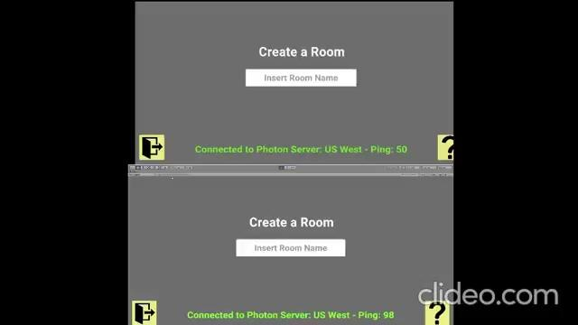
Network Test

Slide 7
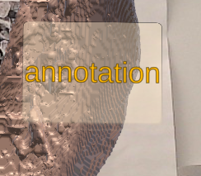
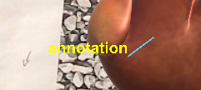
Text Annotation
Rebuilt text annotation system from the ground up, using the methodology used for the other 3D annotations
Previous version was instantiated entirely in the scripts instead of a prefab, making it incompatible with Photon Networking
Annotations are spawned by first entering the text then clicking where on the object it should appear, opposite of previous implementation
Implemented in a generic way and is extendable to other uses (e.g. lasso)

Slide 8
Annotation Deletion
Fall 2021 build wouldn’t accept clicks consistently due to inaccurate hitboxes
Needed to reimplement to delete annotations both on the client and over the network
Reworked the collision detection to use a large box collider for each prefab
Works by entering delete mode then clicking annotations, deleting them instantly
Can be easily applied to new annotations by adding an “annotation” tag to the prefab

Slide 9

Deletion Test

Slide 10
Refactoring and Bug Fixes
Fixed annotations being spawned on empty space when placed on non-model surface
Prevented “Create/Join Room” button from showing till a Photon connection has been established
Fixed the permitted number of players being inconsistent with documentation
Removed tons of dead code, objects, and prefabs
Optimized the bundle size for faster builds
And many more… and there’s still more…

Slide 11
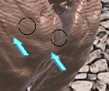
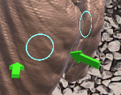
Annotation Position Adjustment
First iteration of annotations were placed at a single angle equal to the camera every time, resulting in clipping and off placement
Calculated the correct placement angle by obtaining the tangent angle using the normal of the raycast hit data
Applied to all annotation types including text

Slide 12
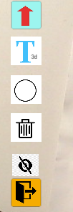
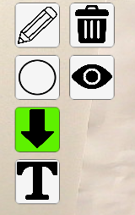
Applied UI Updates
Attempted to increase visibility across the app with consistent coloring
Button color on click is associated with the color of the annotation
Toggle buttons (text, delete) stay in a toggled state during an action

Slide 13
Challenges Faced

Slide 14
Networking
As mentioned, very difficult to get right
Only working annotation was the 2D lasso from Spring 2021 that was not present in Fall 2021
Worked by effectively cloning the action taken on the host on the client
Works in 2D, but extrapolating this approach in 3D is impossible
Needed to refactor all relevant scripting to instantiate and reference objects in the context of the Photon API instead of Unity
Utilized Remote Procedure Calls (RPC) to force an action to occur after it has happened for the host (host places circle, RPC is called on client to place the same circle down)

Slide 15
Existing Code
Fall 2021 code did not work as promised
Networking functionality was non existent
Delete function was hard to use and did not propagate in multiplayer
Compiled build of the app never worked; only worked in-engine
Codebase contained numerous instances of unused objects, making it hard to distinguish between important and useless artifacts
Rerolled to Spring 2021 due to it having the only instance of working networking and had a much cleaner codebase
Was only able to make substantial progress after consulting directly with the Spring 2021 student

Slide 16
Unity Version
The version of Unity used is outdated and nearing end of life
Same story with Vuforia, the AR library used
Old age and relative obscurity of Vuforia and Photon meant finding help online was much harder compared to more well known libraries

Slide 17
Future Work

Slide 18
Improvements
Auto-select client’s model depending on what the host has selected
Exit button on main scene should go to model select instead of app close
Size of annotations should keep size relative to size of model
Anchor image should be replaced with something more ink efficient
Define a standard way to import new models with nodules into the app
More models should be added but with proper mesh colliders and cancerous nodules
Anchor image could be easier to print (e.g. arbitrary QR code)
Current text annotation is missing line from text to the touch point

Slide 19
Features
Annotation deletion mode lets you select multiple annotations before deleting and lets you undo a selection
An ownership system where annotations by the other is marked as such and throws a message if you try to delete and you’re not the owner
New lasso implementation that works in 3D - concept based on the text annotations

Slide 20
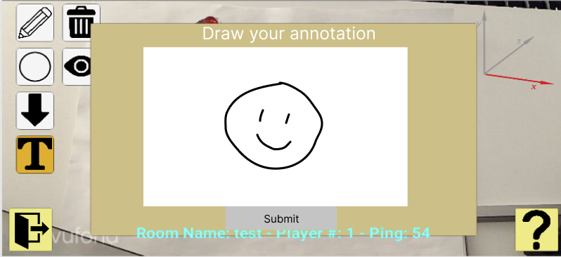
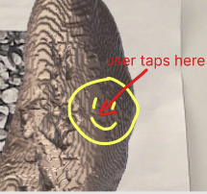
Lasso concept

Slide 21
Overhauls
Port project from Unity 2019 -> 2022; 2019 is at EOL
App needs to be broken up into separate scenes that are loaded in at each menu step instead of everything existing in one space
Change from Vuforia to a better supported library (ARCore for instance)
App should work with or without the anchor image
Refactor annotation code further by creating a generic Annotation class that they inherit from; lots of code is currently repeated
Further refactoring can be done to decouple logic from the massive NetworkManager and ButtonManager classes
Model translation and scaling on touch can be way more user friendly

Slide 22
Thank you for bearing with me!

